Slide 1
Introduction to Software Project Management

Slide 2
Outline
The Fundamental Concepts of SPM
The Challenges in SPM
The Concepts of Management Control in SPM

Slide 3

The Fundamental Concepts of SPM

Slide 4
What is software project management ?
Software Project Management is both an art and a discipline. It involves:
Planning and supervision of software projects, applying structured methods and techniques.
Managing resources, including allocation and timing, to ensure that the final software fulfills the defined requirements.
Providing clarity on project parameters—such as duration, timeline, and cost—for both clients and developers.

Slide 5

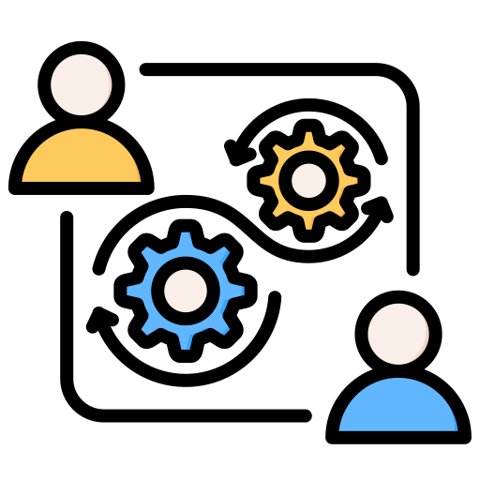

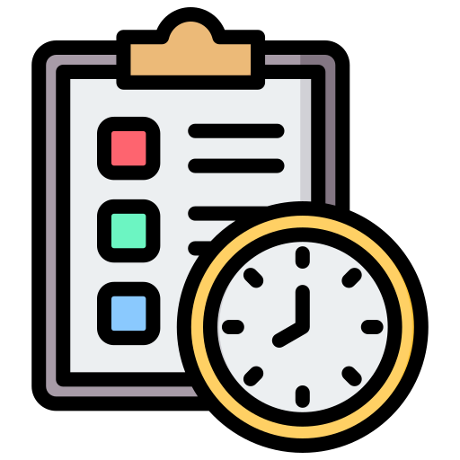
Why Is Software Project Management Important?
Strategic alignment
Clear priorities and objectives
Ensures that software efforts are in harmony with organizational goals.
Sets direction and measurable endpoints.
Strong leadership
Realistic project planning
Promotes feasible scheduling and resource allocation.
Guides teams toward focused results

Slide 6



Why Is Software Project Management Important?
Quality control
Learning from outcomes
Upholds standards throughout development.
Uses successes and failures to continuously improve processes.
Risk management
Anticipates and mitigates uncertainties.

Slide 7
Advantages of Software Project Management
Facilitates the planning of software development, creating a clear roadmap from conception to delivery.
Simplifies the implementation phase, ensuring tasks are executed efficiently and in the right order.
Enables effective monitoring and control, helping teams stay aligned and adapt as needed.
Ultimately helps save time and costs, reducing waste and enhancing resource utilization.

Slide 8
Disadvantages of Software Project Management
Can introduce complexity, making tasks harder to understand—especially for those unfamiliar with project management tools or formal processes.
Involves potential costs, such as investing in high-quality project management software or training team members.
Some team members may face learning challenges, struggling to adapt to new tools or methodologies.

Slide 9
Software Project Planning
Define the Scope of Work
Clearly outline what tasks and deliverables the software project includes. This helps prevent confusion and scope creep later.
Conduct Risk Analysis
Identify potential risks (technical, resource-related, timeline issues) that could impact the project, and plan mitigation strategies.
Determine Required Resources
List all mandatory resources, including manpower, tools, equipment, and budget needed for successful completion.

Slide 10
Software Project Planning
Set Project Goals and Deliverables
Define what the project aims to accomplish, along with measurable success criteria and final deliverables.
Maintain Proper Documentation
Keep a record of the entire planning process, including decisions, assumptions, estimations, and timelines, to ensure traceability and accountability.
Size Estimation
Cost Estimation
Development Time
Resources Requirement
Project Scheduling

Slide 11
Needs for Software Project Management
Software Project Management (SPM) is essential to balance the core constraints of any software project:
TIME
COST
SCOPE
QUALITY

Slide 12
Needs for Software Project Management
⏱ Time
Refers to the project schedule and deadlines.
Delays can increase costs and reduce stakeholder satisfaction.
💲 Cost
Involves budgeting, resource allocation, and financial control.
Overspending can derail the project or reduce profit margins.
✅ Quality
The degree to which the software meets requirements and user expectations.
Rushing or underfunding a project may reduce quality.

Slide 13
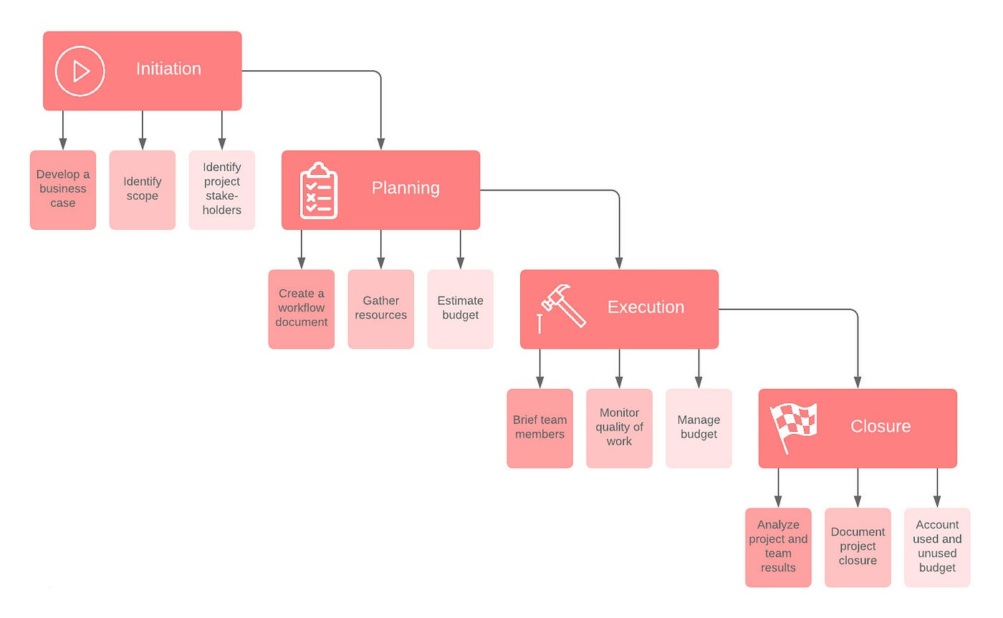
Software Project Management Life Cycle

Slide 14
Software Project Management Life Cycle
🧩 What Is the Software Project Management Life Cycle?
The Software Project Management Life Cycle is a structured framework that guides a software project from beginning to end. It ensures that every phase of the project — from concept to delivery — is planned, monitored, and controlled to meet objectives like time, cost, scope, and quality.
🟦 General Definition:
Software Project Management Life Cycle refers to the sequence of phases a software project goes through, from initiation to closure, to ensure successful planning, execution, and delivery.

Slide 15
Software Project Management Life Cycle
🛠️ Why It’s Important:
Provides a clear roadmap for managing complex software projects.
Helps teams stay aligned with goals, deadlines, and budgets.
Ensures risk identification, proper resource allocation, and quality control.
Promotes accountability by defining roles and deliverables at each stage.

Slide 16
Software Project Management Life Cycle
Initiation Phase
Objective: To define the project at a high level and secure approval to begin.
🔹 Key Activities:
Assess Business Needs
Understand what problem the software aims to solve.
Feasibility Study
Analyze whether the project is technically and financially viable.
Identify Stakeholders
Who will benefit from or be involved in the project?
Develop Project Charter
A formal document outlining objectives, scope, and high-level plan.

Slide 17
Software Project Management Life Cycle
Planning Phase
Objective: To create a roadmap for how the project will be executed, monitored, and closed.
🔹 Key Activities:
Define Scope in Detail
What is included and excluded from the project.
Set Project Objectives
Clear and measurable goals.
Estimate Resources & Budget
How much time, money, and manpower is needed?

Slide 18
Software Project Management Life Cycle
Schedule Activities
Use Gantt Charts, Milestones, or Sprints to plan the timeline.
Plan for Risks
Identify potential obstacles and backup strategies.
Communication Plan
Decide how progress will be reported and to whom.

Slide 19
Software Project Management Life Cycle
Execution Phase
Objective: To actually carry out the work defined in the plan.
🔹 Key Activities:
Develop Software
Coding, designing, and building features.
Conduct Testing
Unit tests, integration tests, and QA cycles.
Manage Quality
Ensure standards and client expectations are met.
Track Progress
Regular status updates, meetings, and monitoring.

Slide 20
Software Project Management Life Cycle
Closure Phase
Objective: To formally close the project and evaluate its success.
🔹 Key Activities:
Final Testing & Approval
Client or stakeholder acceptance of deliverables.
Release Product
Deploy or hand over the software to the client.
Team Release & Handoff
Return resources, and transfer to maintenance team if needed.
Postmortem Review
Lessons learned, success metrics, and process evaluation.

Slide 21
Project Success Criteria
What Defines a Successful Software Project?
To evaluate whether a software project is successful, consider the following key criteria:
Meeting Requirements
The software delivers all specified features and functionality.
Stakeholder Satisfaction
Clients, users, and other stakeholders are happy with the result.
On-Time Delivery
The project is completed within the scheduled time frame.

Slide 22
Project Success Criteria
Within Budget
The project stays within its allocated financial resources.
Product Quality
The software performs reliably, is free of critical bugs, and meets quality standards.
Maintainability & Scalability
The system is easy to maintain, update, and scale for future needs

Slide 23
Common Tools in Software Project Management
Tools That Support Project Planning, Execution & Control
These tools help managers and teams streamline tasks, manage timelines, and track progress:
Tools | Purpose
Gantt Charts | Visual project timelines and task dependencies
Jira | Agile project tracking (issues, sprints, boards)
Microsoft Project | Detailed planning and resource allocation
Trello | Visual Kanban boards for task tracking
Slack / Teams | Communication & collaboration
🔍 Choose tools based on project size, methodology (Agile vs Waterfall), and team needs.

Slide 24
Summary of Fundamental Concepts
Summary of Fundamental Concepts
Software Project Management (SPM) is the structured discipline of planning, leading, and controlling software projects.
It aims to align technical execution with business goals using defined methods and tools.
Core aspects include:
  Project planning (scope, resources, risks)
  Process models and life cycles
  Time–Cost–Quality–Scope balance
  Use of project management tools (Jira, Gantt, EVM)
  Success criteria like stakeholder satisfaction and product quality

Slide 25

The Challenges in SPM

Slide 26
Challenge in Software Project Management
Manager’s Point of View – Challenges
Poor estimation and unrealistic planning
Lack of quality standards or performance metrics
Limited guidance for decision-making
No clear visibility into project progress
Undefined roles and responsibilities
Incorrect or unclear success criteria

Slide 27
Challenge in Software Project Management
2. Team Member’s Point of View – Challenges
Vague or incomplete work specifications
Managers not understanding IT processes
Lack of domain knowledge (application area)
Absence of development and quality standards
No clear quality expectations
Limited involvement in early planning

Slide 28
Challenge in Software Project Management
3. Technical & Documentation Issues
Lack of updated or complete documentation
Technical deliverables delayed by unfinished dependencies
Poor communication between teams and users
Duplication of work due to communication breakdown
Outdated technical references or guidelines
No centralized document management system

Slide 29
Challenge in Software Project Management
4. Commitment & Ownership Problems
Low commitment from key personnel
Over-reliance on one team member
Team members moved before project completion
Lack of ownership mindset
Inconsistent accountability tracking
Minimal recognition for contributions

Slide 30
Challenge in Software Project Management
5. Expertise & Resource Limitations
Narrow technical skill sets in the team
Inadequate training for modern tools or technologies
Lack of backup staff with required competencies
Insufficient onboarding for new team members
Mismatch between roles and expertise
Resource availability not properly planned

Slide 31
Challenge in Software Project Management
6. Changing External Conditions
Evolving statutory/legal requirements
Rapidly changing software environments
Frequent updates in third-party platforms
Unclear adaptation processes for change
Vendor dependency risks
Compliance challenges across regions

Slide 32
Challenge in Software Project Management
7. Time Pressure & Deadlines
Constant pressure to meet tight deadlines
Testing phase often shortened or skipped
Frequent last-minute changes
Developer burnout and overtime
Reduced time for proper documentation
Compromised quality due to speed

Slide 33
Challenge in Software Project Management
8. Quality & Control Issues
Inadequate quality control processes
No standard for code reviews or testing
Bugs detected late in development
Inconsistent QA practices
Lack of automated testing tools
Unclear defect tracking procedures

Slide 34
Challenge in Software Project Management
9. Modern Working Challenges
Remote management and lack of real-time collaboration
Time zone differences causing coordination issues
Low team morale in virtual settings
Over-reliance on asynchronous tools
Difficulty building team rapport online
Lack of real-time collaboration channels

Slide 35
Summary of Key Challenges in SPM
Poor estimation and vague specifications
Limited documentation and communication breakdowns
Scope creep and unclear success criteria
Skill/resource mismatches and over-dependency on individuals
Time pressure, quality issues, and adapting to remote work environments

Slide 36
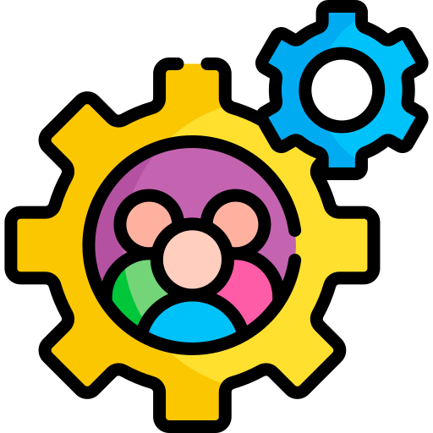
The Concepts of Management Control in SPM

Slide 37
What Is Management Control in SPM?
Management control in software project management refers to the systematic process of guiding a project towards its objectives by continuously monitoring progress, identifying deviations, and implementing corrective actions.
It ensures:
The project stays on schedule, within budget, and aligned with scope.
Proper feedback mechanisms are in place to respond to issues quickly.
The team and stakeholders stay accountable and informed throughout the project.

Slide 38
Why Is Management Control Important?
Without proper control, a project can easily go off track. Here’s why it matters:
Prevents time and budget overruns
Helps manage change effectively
Improves decision-making through data and tracking
Promotes accountability among teams
Ensures quality standards are maintained
Builds trust with stakeholders by providing transparency
Effective control is not about micromanaging — it’s about steering the project toward success with foresight and agility.

Slide 39
Key Elements of Control in SPM
Management control can be broken down into six core focus areas:
Time Control – Managing schedules and deadlines
Cost Control – Monitoring budgets and expenditures
Scope Control – Ensuring agreed deliverables are met
Risk Control – Identifying and mitigating risks early
Quality Control – Meeting technical and user expectations
Communication Control – Keeping all parties informed
Each of these elements must be regularly reviewed and adjusted based on real-time project performance.

Slide 40
1. Time Control
Time is one of the most critical constraints in any project. Time control includes:
Creating schedules with start and end dates
Breaking work into tasks and milestones
Using tools like Gantt charts, Kanban boards, or Sprint backlogs
Holding daily stand-ups or weekly syncs to check progress
Reallocating resources if delays are forecasted
Using timeboxing techniques in Agile to enforce strict timelines
A delay in one task often impacts many others — hence tight time control is key.

Slide 41
2. Cost Control
Keeping spending in check is essential to avoid budget overruns. This involves:
Estimating costs during planning and tracking actual expenses during execution
Performing cost variance analysis to detect overspending early
Using Earned Value Management (EVM) for integrated cost/schedule control
Approving only authorized expenditures
Updating stakeholders if a budget change is unavoidable
Even small unexpected costs can escalate quickly without proper control.

Slide 42
3.Scope Control
Scope refers to the total set of deliverables expected. Without scope control:
You risk scope creep (adding features without adjusting time or cost)
You may deliver something different from what was agreed
Scope control techniques include:
Using a Work Breakdown Structure (WBS)
Tracking changes through a Change Control Board (CCB)
Regularly validating deliverables against original requirements
Maintaining a Requirements Traceability Matrix

Slide 43
4.Risk Management Control
Risks are inevitable. Management control involves:
Identifying potential risks early through brainstorming or checklists
Evaluating them based on likelihood and impact
Creating mitigation plans for high-risk scenarios
Keeping a risk register with status updates
Reassessing risks regularly during the project lifecycle
A proactive approach to risk reduces firefighting and last-minute panic.

Slide 44
5.Issue Tracking & Escalation
While risks are hypothetical, issues are problems that already occurred.
Good issue control means:
Logging issues in a centralized issue tracker
Assigning clear ownership for resolution
Setting deadlines and escalation paths if unresolved
Reviewing issues during regular team or stakeholder meetings
Analyzing root causes to avoid recurrence
Unmanaged issues lead to delays, conflict, and dissatisfaction.

Slide 45
6.Quality Control
Delivering software that works isn't enough — it must work well. Quality control ensures:
Compliance with technical standards and coding guidelines
Execution of testing procedures (unit, integration, system, UAT)
Reviews such as peer code reviews, walkthroughs, and inspections
Tracking defects and resolution cycles
Tools like SonarQube, Selenium, or manual testing methods
Quality control is about doing it right the first time.

Slide 46
7.Communication Control
Effective communication is the glue that holds everything together.
Control mechanisms include:
A communication plan defining what gets reported, to whom, and how often
Tools like Slack, Teams, Email, Jira for ongoing coordination
Stakeholder updates (status reports, dashboards, presentations)
Meeting schedules and minutes to document decisions
Avoiding over-communication (noise) and under-communication (blind spots)
Transparency and clarity reduce confusion, rework, and frustration.

Slide 47
Monitoring Tools in SPM
You can’t control what you don’t measure. Popular tools include:
Gantt Charts – visualize timelines and task dependencies
Burndown Charts – monitor progress in Agile
Project Dashboards – track KPIs and performance
Jira / Trello / Asana – manage tasks and workflows
Time Tracking Tools – for cost/time analysis
Issue Logs & Risk Registers – for governance

Slide 48
Earned Value Management (EVM)
Earned Value Management (EVM)
EVM helps you quantitatively assess project performance. Key terms:
Planned Value (PV) – work planned up to a point
Earned Value (EV) – work actually completed
Actual Cost (AC) – money spent so far
Using EVM, you can calculate:
Schedule Variance (SV) = EV - PV
Cost Variance (CV) = EV - AC
Positive variance = on track. Negative = corrective action needed.

Slide 49
Change Control Process
Change is inevitable. Managing it effectively includes:
A formal process for submitting change requests (CRs)
Analyzing impact on time, scope, and budget
Decision-making by a Change Control Board (CCB)
Documenting all approved or rejected changes
Communicating outcomes clearly to affected parties
Good change control avoids chaos and uncontrolled growth.

Slide 50
Key Performance Indicators (KPIs)
KPIs help you quantify performance. Examples include:
% of completed tasks vs planned
Number of open vs closed bugs
Sprint velocity (Agile)
Burn rate (cost over time)
Customer satisfaction or NPS
Time-to-market for features
Choose KPIs that align with your project goals and update them regularly.

Slide 51
Summary & Best Practices
To wrap up:
Use real-time monitoring to control deviations
Focus on preventive actions, not reactive fixes
Communicate consistently and clearly
Balance flexibility with control
Leverage tools and dashboards effectively
Strong management control doesn’t slow down projects — it makes success repeatable and reliable.

Slide 52
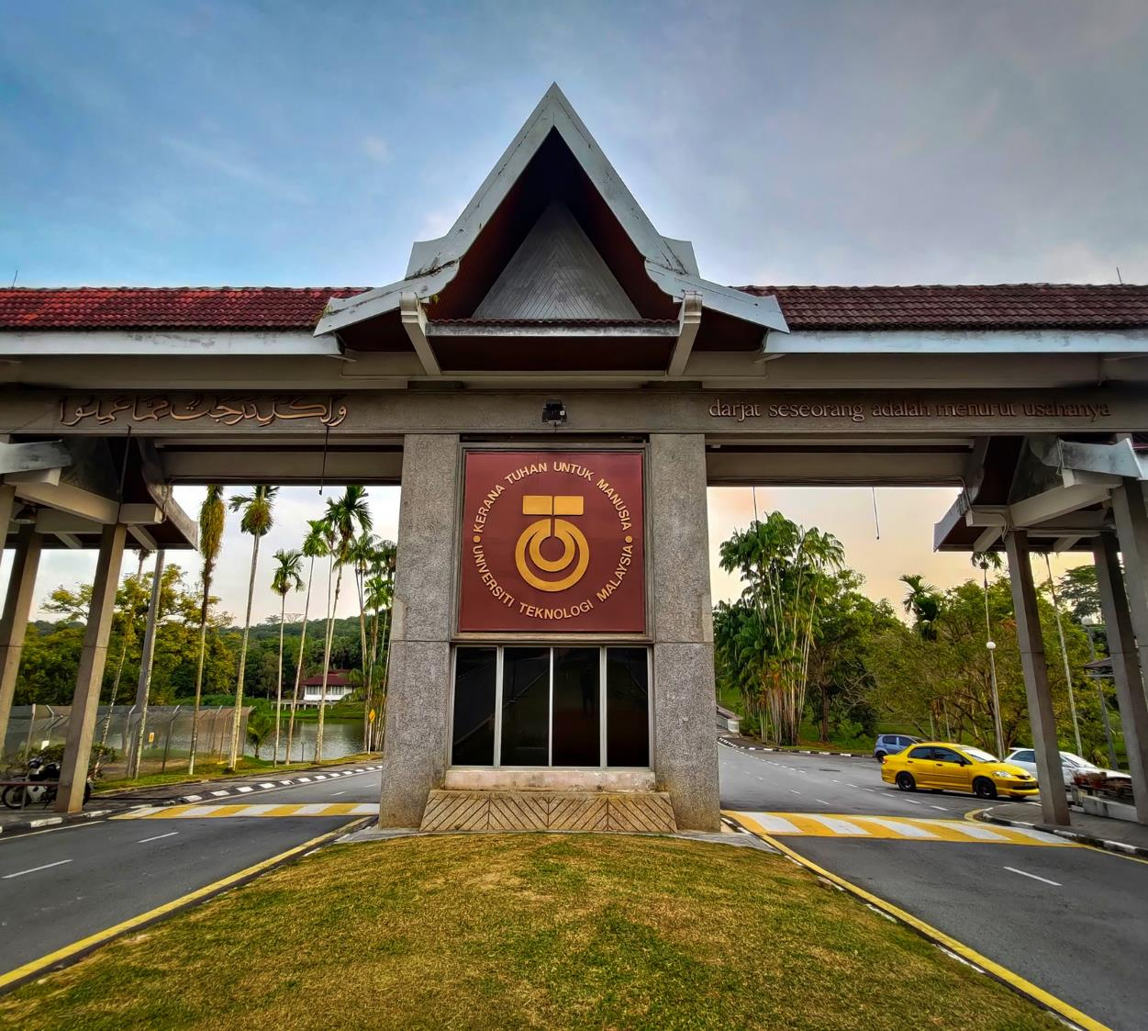






THANK YOU
In the Name of God for Mankind
www.utm.my

